Slide 1

Java for Beginners
Level 4b
Mr. Teasdale

Slide 2
Levels of Java coding
1: Syntax, laws, variables, output
2: Input, calculations, String manipulation
3: Selection (IF-ELSE)
4: Iteration/Loops (FOR/WHILE)
5: Complex algorithms
6: Arrays
7: File management
8: Methods
9: Objects and classes
10: Graphical user interface elements

Slide 3
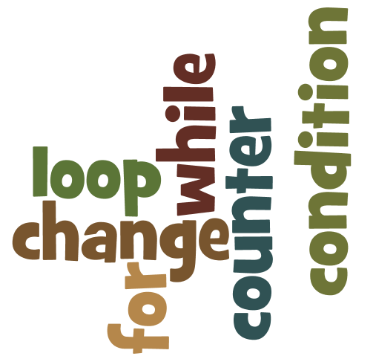
What do you learn last time?
Wordle.org

Slide 4

for(counter; condition; change)
A logic condition (like in IF) that has to be true for the loop to continue.
Something Operator Something (usually involving the counter variable)
A simple variable (usually an int) that allows the loop to ‘step through’
Normally called “i”
What should happen to the counter variable value at the end of the loop
Usually i++ or i--

Slide 5
What is the difference?
“Now count from one to ten…”
Loops
FOR
Known number of repetitions
WHILE
Unknown number of repetitions
“Are we there yet?...”

Slide 6
condition variable while(condition) change happens inside loop
A variable is created and given a value so that the loop will run. Usually String, int or boolean
A logic condition (like in IF) that has to be true for the loop to continue.
Something Operator Something (usually involving the counter variable)
There must be an opportunity for the condition variable to change, sometimes done in an IF block

Slide 7
Typical example (while loop)
Create int called i
Set i to 0
Continue while i is less than 3
int i = 0;
while (i < 3)
{
System.out.println(“gum”);
i++;
}
At end of for loop, increase i by 1
Output
gum
gum
gum

Slide 8
Another example (while loop)
boolean done = false;
while (done == false)
{
System.out.println(“Are you done? Y/N ”)
String answer = kb.nextLine();
if (answer.equals(“Y”) )
{
done = true;
}
System.out.println(“Goodbye!”);
}
Create boolean called done.
Set to false
Continue while done is false
If user enters Y, set done to true
Output
Are you done? Y/N
Y
Goodbye!

Slide 9
Students struggle with…
FOR LOOPS – WHILE not so much
Some students will bizarely understand while loops much easier than for loops.
They can use whichever on they prefer
Most common mistake:
while(done == false);

Slide 10
Practice time
Generate two random numbers between 1 and 10.
Calculate their sum (num1 + num2).
Ask the user for their sum.
If they get it right, the program congratulates them and ends.
If they get it wrong, the program repeats by generating two more numbers and asking the user again…
Read problem
Make list of sub-tasks
Draw flowchart
Code in Java

Slide 11
Sum:
num1+ num2
Display num1 and num 2
Num2:
random number between 1 and 10
Ask user for total
Num1:
random number between 1 and 10
if total = sum
False
Start
True
Display Well done!
End

Slide 12
Possible solution
boolean done = false;
while (done == false)
{
int num1 = 1 +(int)(Math.random()*((10 - 1) + 1));
int num2 = 1 +(int)(Math.random()*((10 - 1) + 1));
int sum = num1 + num2;
System.out.println(“What is ”+num1+” + “+num2+” ?”);
String answer = kb.nextLine();
int total = Integer.parseInt(answer);
if (total == sum)
{
done = true;
}
}
System.out.println(“Well done!”);

